Slide 1
European Exploration and Interactions

Slide 2
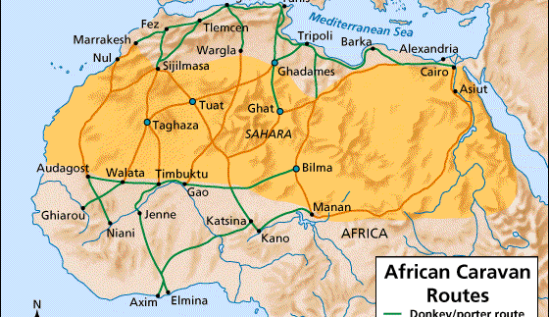
Motives for European Explorations
z
Demand for Asian and African goods. (gold, pepper, nutmeg, etc.)
Access to these goods was only available through the Silk Road or Trans-Saharan trade routes.
Muslims controlled access to both of these routes and charged Europeans heavy taxes.
This arrangement lead to the Crusades and later the European explorers looking for an oceanic route to Asia and Africa.

Slide 3
Early Explorations from Europe
New technologies enabled Europeans to strike out farther than ever before.
Lateen sail, compass, astrolabe and quadrant.
Explorations of the Mediterranean Atlantic to the South and West of Spain led to new Portuguese colonies and slave trade.
Another important discovery…the Westerlies, the winds that made the return trip to Europe possible.

Slide 4
Portugal: Colonies and Start of the Atlantic Slave Trade
The Portuguese were the first to explore and colonize the islands of the Mediterranean Atlantic: Azores, Madeiras and Canaries.
Azores were uninhabited and the Portuguese used them to grow wheat and livestock for sale to European travelers.
The Madeiras on the other hand, were used to grow the crop that would become the most profitable and sought after…sugar.
Sugar was the first crop to be grown exclusively on colonial plantations. Heavy use of slaves here would lead to the Atlantic Slave trade.

Slide 5
Portugal: Colonies and Start of the Atlantic Slave Trade Continued
Whereas the Azores and Madeiras had been uninhabited, the Canaries were not.
The Guanches were the indigenous people of the Canaries who initially resisted European invasion, but by 1496 succumbed to disease and were conquered by Spain.
Many Guanches were made into slaves to work the sugar plantations of the Madeiras.

Slide 6
Portuguese Explorers
Prince Henry the Navigator routinely dispatched ships further South in hopes of finding and oceanic route to Asia.
After Henry’s death, became the first European to go around the Southern tip of Africa in 1488.
Vasco da Gama would become the first to reach India in 1498.

Slide 7
Portuguese Exploitation of West Africa
Europeans did not have the power to force their way into Africa.
In the late 1400’s Portugal established trading posts in West Africa.
Portuguese traded European goods like guns and textiles for African ivory, gold and slaves.
In 1480 Portugal colonized Sao Tome and turned it into a massive sugar plantation, thus dramatically increasing the demand for slaves from the African mainland.
Sao tome became the first economy based on the exploitation of African slaves.

Slide 8
Christopher Columbus
Born in Genoa 1451.
Spent time captaining a merchant ship off of Madeira.
He knew the Earth was round but thought that the coast of India was only 3,000 miles from Spain (It’s actually 12,000).
Sought a Western passage to India.
He was turned down by Portugal, but Ferdinand and Isabella of Spain were hungry for riches and were jealous of Portugal.
Mostly financed by Spain and given 3 ships (Nina, Pinta, Santa Maria).

Slide 9
Columbus Continued…
Landed on an island in the Bahamas called Guanahani, but renamed it San Salvadore.
Later traveled to Hispaniola and Cuba.
3 Themes: 1. Where is the gold and pearls? 2. Strange plants and animals. 3. Inhabitants could make good servants and converts to Catholicism.
Made 3 more voyages
Encomienda System…

