Slide 1
Types of Governments

Slide 2
Creating a Government Debrief
How did your group make decisions?
How did you feel during this activity?
What are the advantages and disadvantages of a group agreeing upon a decision?
What are the advantages and disadvantages of an individual making decisions for everyone else?
Do you think the average person can be trusted to govern?

Slide 3
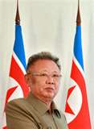
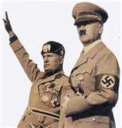
Autocracy
A government in which one person possesses unlimited power

Slide 4
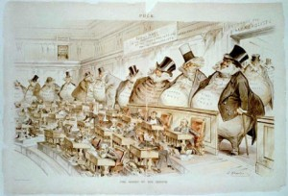
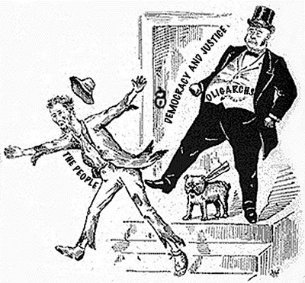
Oligarchy
A government in which a few people have power

Slide 5
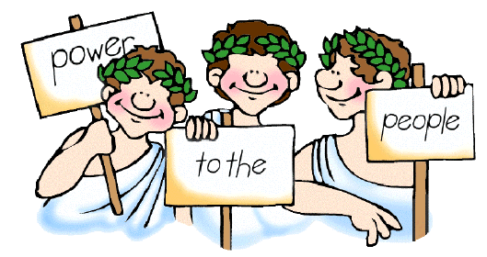
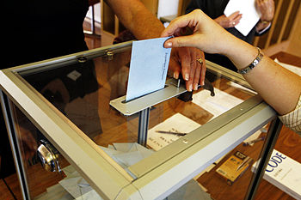
Democracy
A government in which power rests with the people

Slide 6
AUTOCRATIC OR DEMOCRATIC?
A teacher decides there will be a test on Friday.
A group of friends decide on which movie to see by discussing three possible movies and voting on which one they want to see.
A manager of a fast food restaurant decides to give workers a $0.50 per hour raise.
A mother listens to her daughter complain about not being allowed to stay out late at night and then decides to let her daughter stay out one hour later.

Slide 7
AUTOCRATIC OR DEMOCRATIC?
A mother, father, and their three children all choose to go to the beach for vacation, even though one child wanted to go camping in the mountains.
Todd plans a surprise romantic night for his girlfriend Dana. He takes her to dinner at her favorite restaurant and then takes her dancing at a new club.
The mayor, elected by the citizens of the town, decides to build a new city hall.
The citizens vote in favor of a city tax measure that would increase funding for libraries.

Slide 8
Types of Democracy
Direct: all citizens take direct part in the day-to-day affairs of government
Indirect: citizens elect representatives who take part in the day-to-day affairs of government

Slide 9
