Slide 1
The progressive era
Ch.18

Slide 2
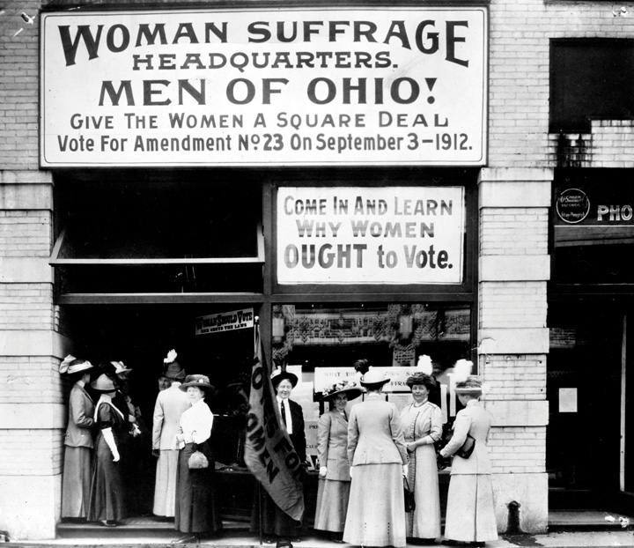
National Associations and foreign influences
National organizations that focused on specific interests became nationwide. (American Bar Association, National American Woman Suffrage Association, etc.)
Acted outside political parties and were very issue focused.
Ideas like the settlement house, compensation for victims of industrial accidents, subsidized housing for workers, and rural reconstruction were adopted from European countries by Americans who studied abroad.

Slide 3
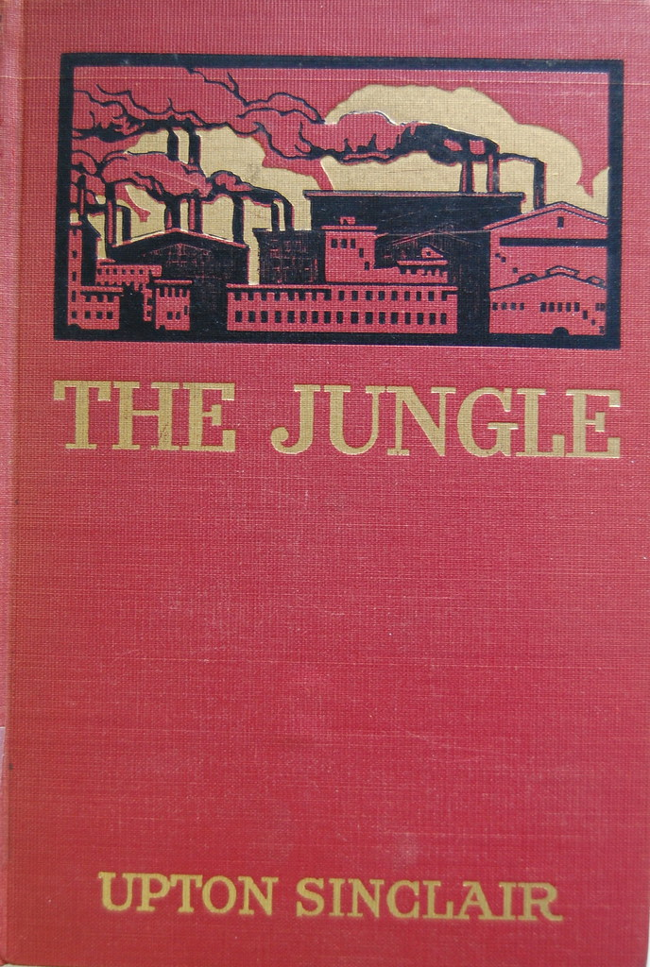
The new middle class
Progressive goals: ending abuse of power, welfare protection for all classes, reforming institutions, and promoting social efficiency.
The new professionals that made up the middle class spearheaded these goals by applying the same rationality they used in their professions to social issues.
Journalists who Theodore Roosevelt called “muckrakers” focused on scandals that exposed social, economic and political wrongs.
One of the most famous was Upton Sinclair’s The Jungle, that exposed outrages of the meatpacking industry and plights of working-class immigrants.

Slide 4
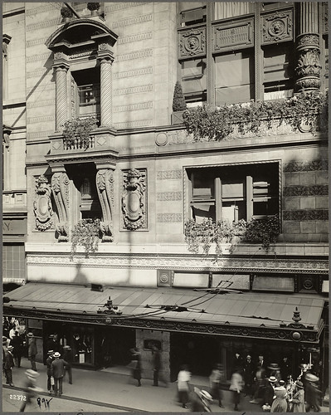
Reformers and settlement houses
Progressives sought to fight corruption by getting away from party politics and instituting referendums and the ability to recall corrupt officials.
Progressives included some of the wealthy men and women who used their wealth and influence for Progressive causes such as the Young Women’s Christian Association (YWCA) that supported unmarried working women and settlement houses.
Young middle-class men and women tried to bridge the working-class and wealthy neighborhoods through the construction of settlement houses.

Slide 5
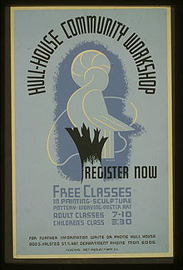
Settlement houses
Between 1886 and 1910, over 400 established in the inner-cities.
Lessen modern problems through education, art and reform.
Sponsored English-language classes, kindergartens, nurseries, clinics and vocational training.
Jane Addams and Florence Kelly of Hull House in Chicago earned recognition for their work.
Kelly would be appointed Illinois state factory inspector for her investigations into child labor exploitation, and Addams would win the Nobel Peace Prize in 1931 for her work.

Slide 6
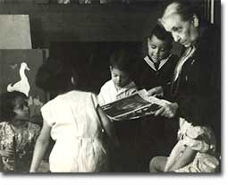
Working class reformers and the social gospel
By 1900 working class reformers were pushing for safe factories, shorter workdays, workers’ comp, and other “bread and butter” reforms.
Some political Bosses like “Big Tim” Sullivan supported working class reforms.
Working class opposed Prohibition, Sunday closing laws, civil service and non-partisan elections.
The Protestant Social Gospel movement countered “cut-throat” capitalism by helping the poor, that helping others would help create “God’s kingdom on Earth”.
Secular reformers tried to assimilate immigrants and Indians through education, economic and cultural opportunities.

Slide 7
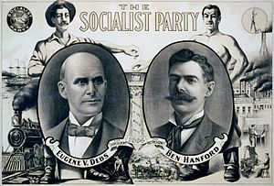
Socialists
Disillusioned immigrants, intellectuals, former Populists, activists and workers turned to socialism.
Wanted government sponsored social programs like low-cost housing, worker’s comp, pensions, and municipal services.
By 1912 the Socialist Party of America claimed 150,000 members and 700,000 subscribers.
Eugene V. Debs was the Socialist candidate who won nearly 900,000 votes in 1912.
Most reformers favored socialist ideals, but the increase in taxes that would come with their programs turned them off.

Slide 8
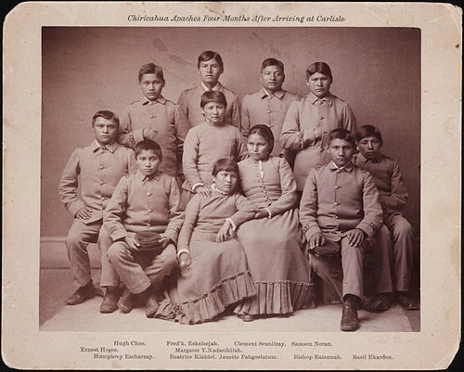
Southern and Western progressives and opponents of progressivism
The direct primary originated in North Carolina, where the people directly nominate party candidates for president.
Other progressive regulatory bodies emerged in Texas, Virginia, Nevada, and California.
In western states, women could vote in local elections.
Most women activists worked outside politics and pursued different projects largely determined by race.
Opponents of Progressivism tended to be people who hated government interference and big business tycoons who liked the free market.
Many Progressives discriminated against minority groups, and tended to be more moderate than liberal.

Slide 9
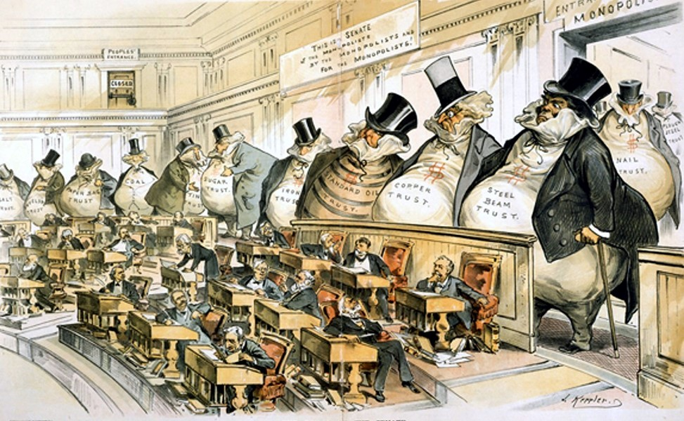
Restructuring government
Progressives rejected laissez-faire government in the Industrial Age and the corruption in government that came with it.
1900 campaigns promoted efficiency created city manager and commission governments so that officials would be chosen for their skills not their connections.
Progressive governors like Wisconsin’s Robert M. La Follet “Battling Bob” instituted reforms in regulation, taxes, and primaries.
Progressive efforts led to the 17th Amendment that made Senators elected by popular vote rather than be appointed by state legislatures.

Slide 10
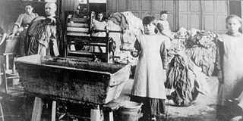
Labor reforms
Middle-class coalitions helped pass factory inspection laws.
By 1916, 2/3 of states required compensation for victims of industrial accidents.
The National Child Labor Committee helped push for nearly every state to set a minimum age for employment.
Laws passed to limit a woman’s workday (Muller v Oregon set a 10hr workday).
The American Association for Old Age Security set precedent by securing old-age pensions in Arizona.

Slide 11
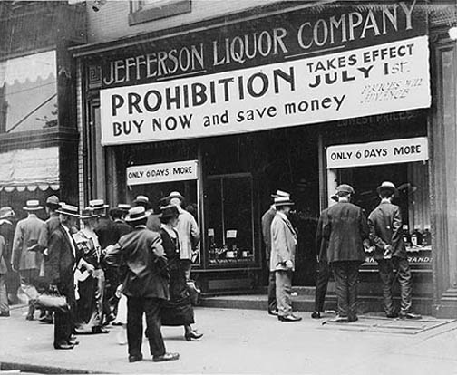
Prohibition
Some reformers tried to regulate people’s behavior like the Anti-Saloon League and Women’s Christian Temperance movement.
They linked alcoholism to things like: health and family problems, accidents, poverty, and poor productivity.
By 1900 ¼ of Americans lived in “dry” communities that prohibited liquor sales.
1918 Congress passed the 18th Amendment, outlawing liquor manufacturing, sale, and transportation.

Slide 12
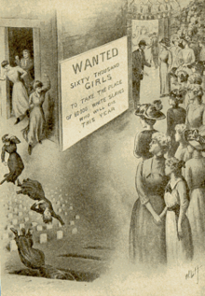
Controlling Prostitution
Muckrakers claimed that international gangs were kidnapping women and forcing them into prostitution and called this “white slavery”.
Created a false link between immigration and prostitution.
In 1910 Congress passed the White Slave Traffic Act (Mann Act) that prohibited the international transportation of women for “immoral” purposes.
By 1915, almost every state outlawed brothels and solicitation of sex.

