Slide 1
WWI Red Scare
Ch.20.3/4

Slide 2
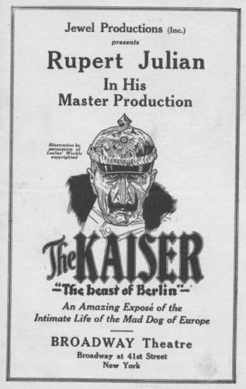
Committee on Public Information (CPI)
Formed in April 1917 and headed by Progressive journalist George Creel.
Used propaganda to mobilize public opinion.
Encouraged the press to “self-censor” and people to spy on their neighbors.
Anti-German sentiment bred ultrapatriotic groups and nativism that tried to remove anything German from the country.
Pacifist and antiwar advocates were often fired and persecuted.

Slide 3
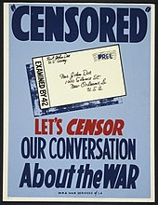
Espionage and Sedition Acts
The Espionage Act of 1917 outlawed “false statements” that impeded the draft and encouraged disobedience in the military.
Also banned mailing anything considered treasonous.
The Sedition Act of 1918 made it illegal to obstruct the sale of war bonds and to use “disloyal, profane, scurrilous, or abusive language” about the gov’t, flag, Constitution, or the military uniform.
More than 2,000 people were prosecuted and many more were intimidated.

Slide 4
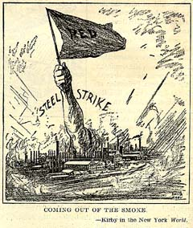
Red Scare: Labor Strikes
The Soviet Union and their promotion of Communist International terrifies conservative Americans, who begin to seek out communists and communist sympathizers.
In 1919 unions wage more than 3,300 strikes involving 4 million workers.
On May 1st, bombs were sent to prominent Americans.
Most were intercepted, but anarchists were blamed.
Bolshevik conspiracies are blamed for other strikes and unrest (Boston Police, U.S. Steel Corporation).
John Reed and Benjamin Gitlow found the Communist Labor Party in 1919, the rival Communist Party of the United states of America also founded, but membership was no more than 70,000 combined.

Slide 5
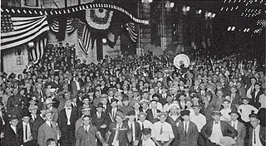
American Legion
Formed in May 1919, initially to lobby for veteran’s benefits.
Began preaching antiradicalism that fueled the Red Scare.
Attorney General(AG) Palmer appoints J. Edgar Hoover to head the Radical Division of the Department of Justice(DOJ).
Hoover compiles lists of allegedly radical people and groups.
In 1919, they jailed IWW members and some 249 alien radicals including Emma Goldman were deported to Russia.
Legionnaires often used violence against IWW members and socialists.

Slide 6
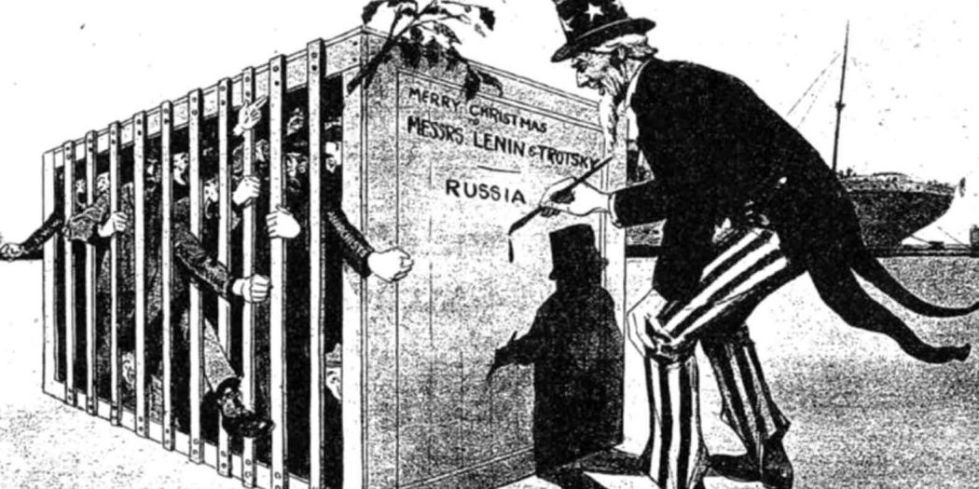
Palmer Raids
January 1920, J. Edgar Hoover directed raids by government agents in 33 cities.
Broke into meeting halls and homes without warrants and jailed 4,000 people with no legal counsel.
Boston: 400 people detained on Deer Island, 2 died of pneumonia, one leaped to his death and another went insane.
Due to court rulings and Assistant Secretary of Labor Louis Post’s efforts, most were released.
But in 1920-1921 almost 600 deportations.
Palmer accused of violating the Constitution and alarmed everyone when he proposed a peacetime sedition act.

Slide 7
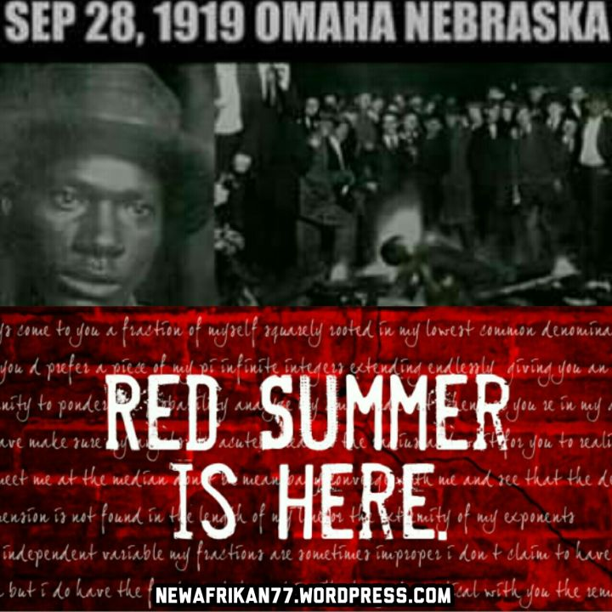
Racial Unrest
Palmer blamed communists for racial unrest.
Revival of the Ku Klux Klan and the release of D.W. Griffith’s racist film The Birth of a Nation in 1915.
Between 1914 and 1920, 382 African Americans were lynched, some in military uniform.
Race riots broke out in St. Louis and Houston in the summer of 1917.
James Weldon Johnson calls the summer of 1919 “Red Summer” for all the blood spilled.
Summer of 1919 race riots broke out in 2 dozen cities and towns.
The worst was in Chicago with 38 deaths.

Slide 8
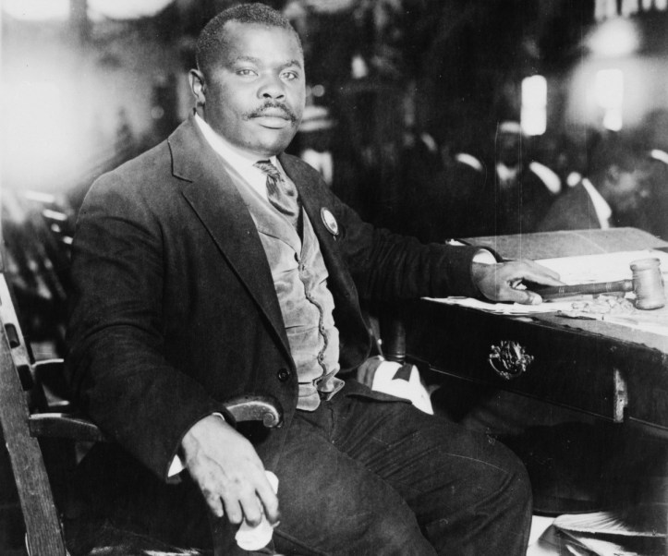
Black Militancy
W.E.B. Dubois and poet Claude McKay call for African Americans to fight back.
African American publications criticize white politicians.
NAACP seeks legislation against lynchings in 1919.
Marcus Garvey doubts potential for equality and proposed a separate nation for African Americans.
The 19th Amendment that gave women the right to vote was the exception to the trend of civil rights violations of the time.

