Slide 1
Motives for Imperialism

Slide 2
Show Me the Money!
Industrial needs
Natural resources
New markets
Population outlets

Slide 3
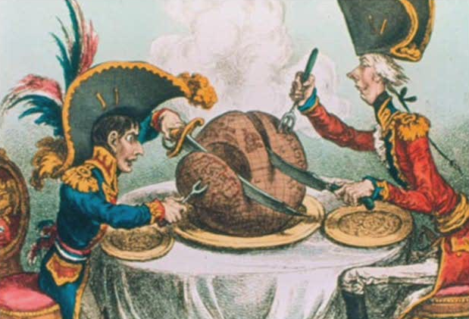
Domination
Bases for refueling
Nationalism
Security
Prestige

Slide 4
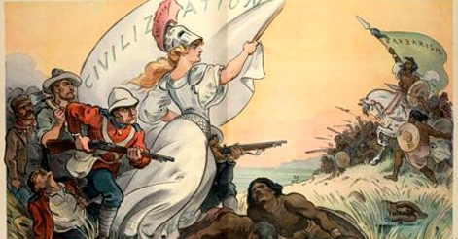
“The White Man’s Burden”
European Culture
Religion
Law and medicine
Social Darwinism

Slide 5
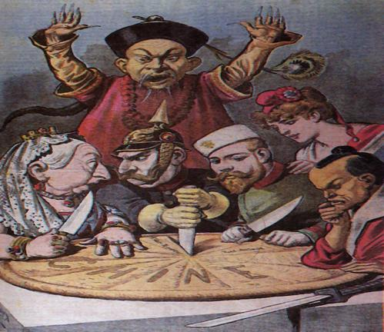
Decline of Non-Western States
Ottoman Empire
India
Qing China
Africa

Slide 6
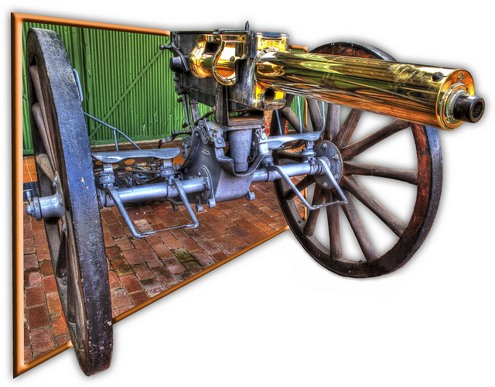
European Advantages
Strong Economies
Superior Technology
Organized governments
Powerful Armies and Navies
Weapons

Slide 7
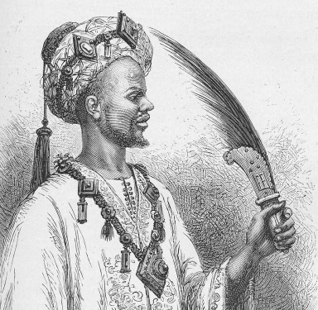
Resistance
Some fought back
Protests at home
Hypocrisy
Immoral

Slide 8
Forms of Imperial Rule
France: Direct rule
Britain: Indirect rule
Protectorate
Sphere of influence

Slide 9
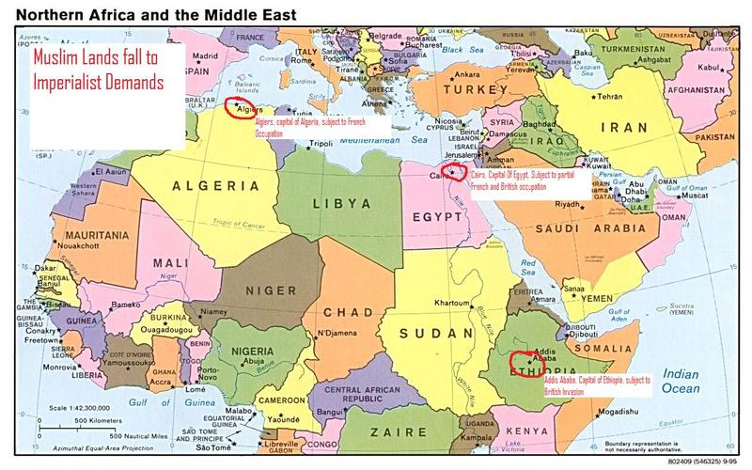
Partition of Africa: North Africa
The Sahara
Fertile Land along Mediterranean
Muslim World
Ottoman Empire (Sick man of Europe)

Slide 10
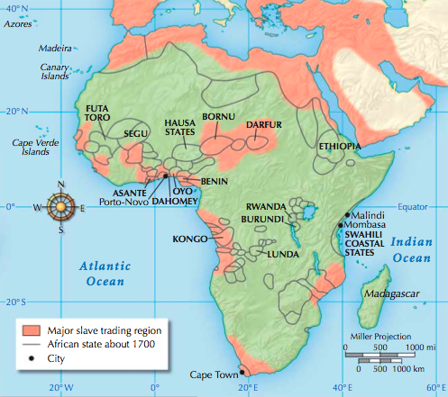
West and East Africa
Islamic Revival early 1800s
Usman dan Folio (Nigeria)
Trade with Middle East
Slaves, ivory, copper

Slide 11
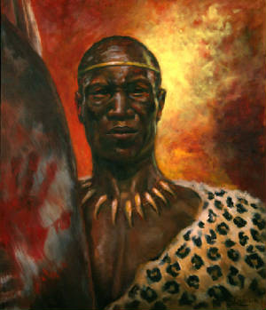
Southern Africa
Shaka Zulu: 1818-1828
Expansion of Zululand
1830s Dutch Boers
Migrating north from Capetown
“Great Trek” escape from British

