Slide 1
Media Analysis
Core Concepts and Examples

Slide 2
Core Concept #1
Author/creator: All media messages are “constructed.”
High Fructose Corn Syrup Ad
Notes:
http://youtu.be/QWVFVNpEJFw

Slide 3
Core Concept #2
Audience: Different people experience the same media message differently.
Notes:
http://www.youtube.com/watch?v=S6HHCxLZftQ

Slide 4
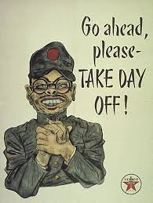
Core Concept #3
Historical context: Media messages give insights into the historical time period in which they are constructed.
ALS #Ice Bucket Challenge

Slide 5
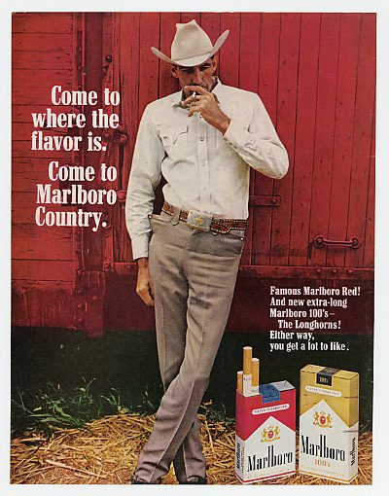
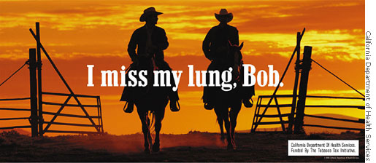
Core Concept #4
Message: Media have embedded values and points of view.

Slide 6
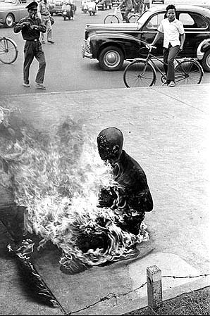
Core Concept #5
Medium (and production techniques): Media messages are constructed using a creative language with its own rules.

Slide 7
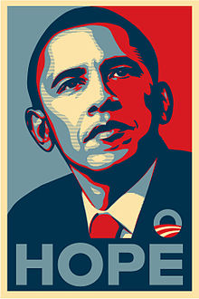
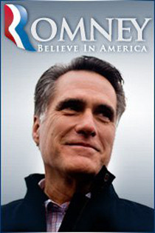
Core Concept #6
Motive or purpose: Media are organized to gain profit and/or power.

Slide 8
Persuasion
https://www.youtube.com/watch?v=6NEoesmnYU4
Example 1
Example 2
https://www.youtube.com/watch?v=Q65KZIqay4E
https://www.youtube.com/watch?v=w211KOQ5BMI&list=PL2EbESdPFdo5k3AP86CsV5zsp3vw3KzqU

