Slide 1
Industrial reforms
7.3-7.4

Slide 2
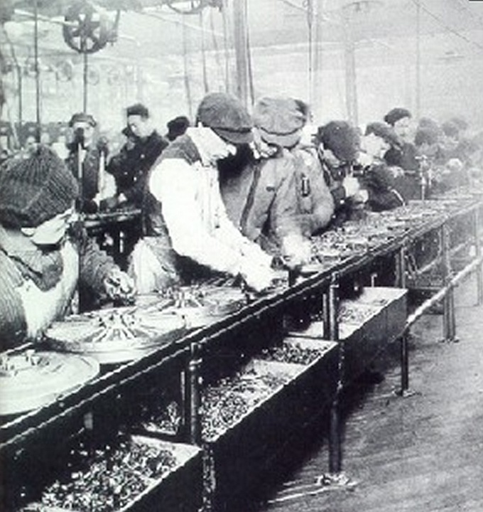
Industrialization spreads
1793: first American factory in Rhode island
Mass production
Interchangeable parts
The assembly line changes the workplace
Division of labor
Specialization (one person=one job)

Slide 3
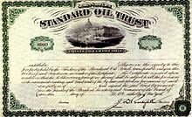
Rise of corporations
Building large businesses takes lots of money.
Entrepreneurs sell stocks to raise $$
Corporations are businesses owned by stockholders.
Large corporations control whole industries.

Slide 4
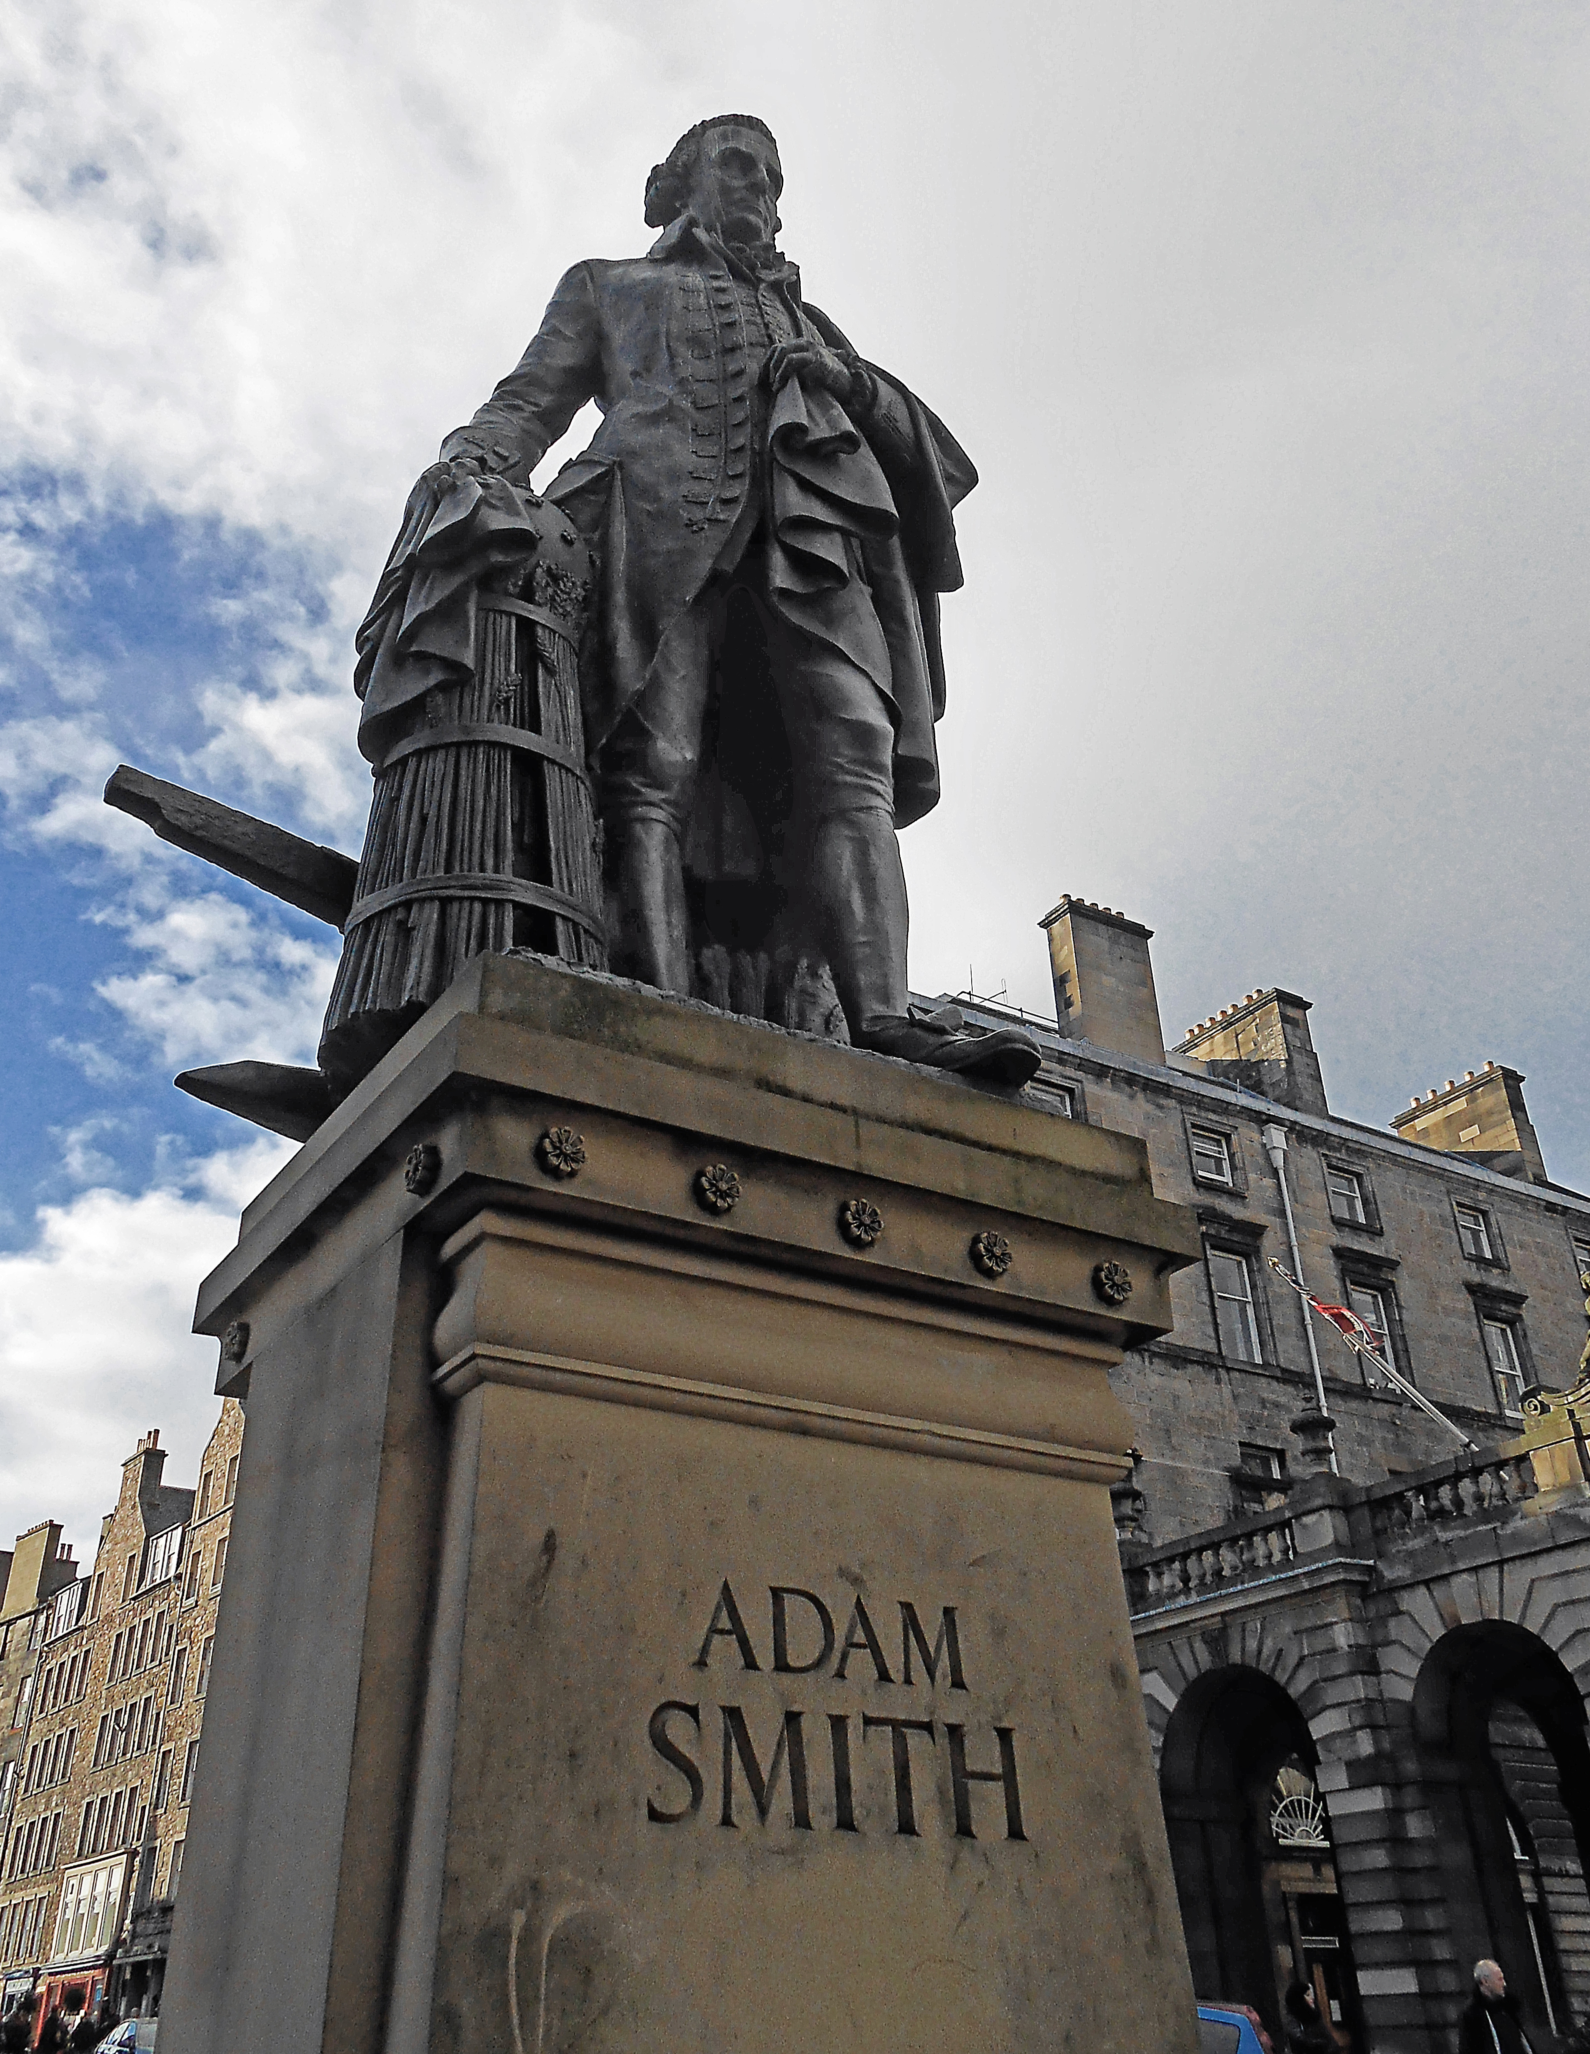
capitalism
Adam smith’s the wealth of nations
Laissez faire=“hands off!”
Business for profit
Factors of production (land, labor, capital} are privately owned
Smith, malthus, ricardo oppose government help to poor

Slide 5

Rise of socialism
Jeremy bentham, John Stuart mill/ utilitarianism
Socialism=factors of production should be owned and run for public good.
Utopianism
Robert owen’s new Lanark/new harmony
Only lasted 3 years
Social democracy

Slide 6

marxism
The communist manifesto by karl marx and friedrich engels
The Bourgeoisie=“haves” vs. the proletariat=“have nots”
Capitalism creates class warfare
Solution=communism (classless society)
Russia, china, cuba, vietnam

Slide 7
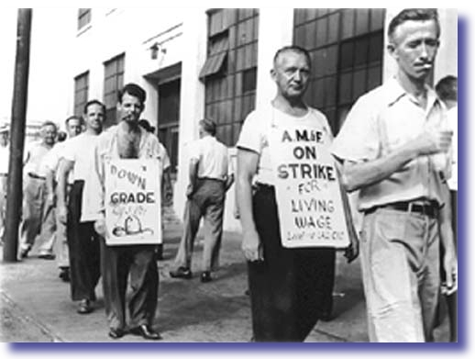
Labor unions and reform laws
Workers unionize to bargain for better working conditions
Unions could strike (refuse to work) if demands not met.
Skilled workers lead the way!
Unions eventually win higher wages and shorter hours by late 18oo’s.

Slide 8
Reform movements
Abolition of slavery in British empire by 1833/USA by 1865
Women’s rights movement
Voting rights for all.

