Slide 1
Colonial Rights and growth of self government

Slide 2
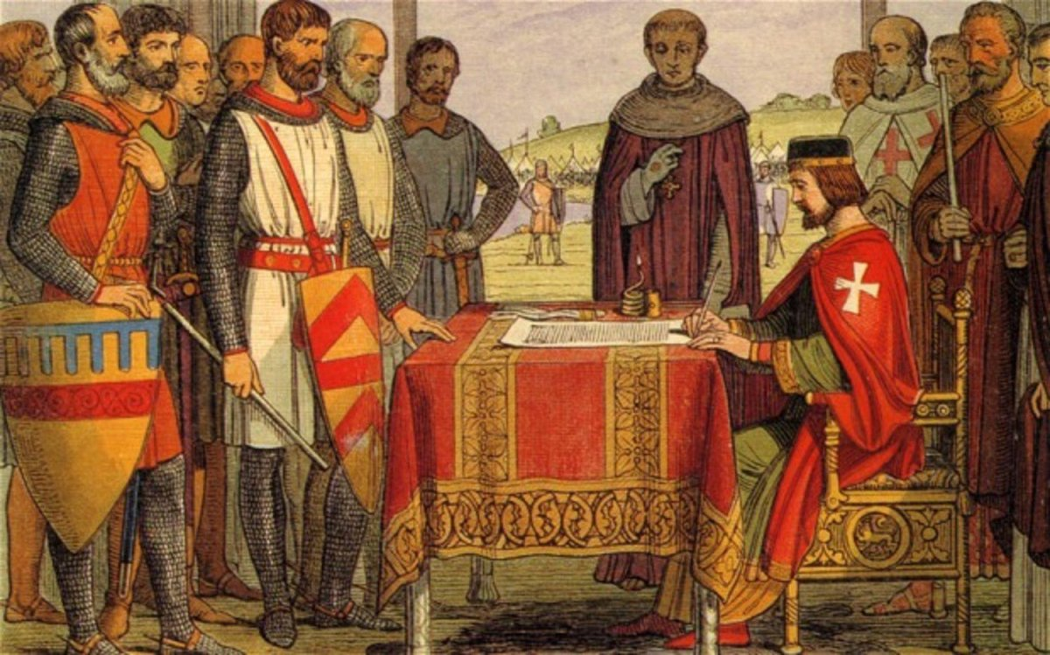
Magna Carta: The rights of englishmen
Magna carta or “great charter” signed in 1215.
Agreement between King John and rebellious barons
Listed rights granted to “all the freemen of our kingdom”

Slide 3
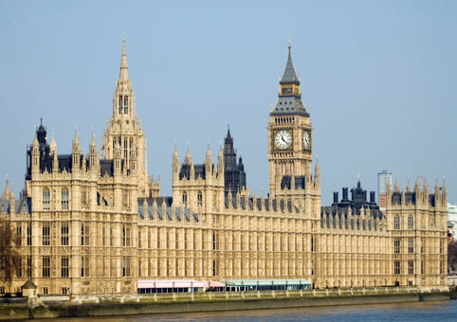
Rights gained from the magna carta
Due process of law: government can’t deprive anyone of life, liberty or property unless there is a written law.
Led to the establishment of parliament which was the English legislature.
No taxation without representation!
No one is above the law, not even the king!

Slide 4
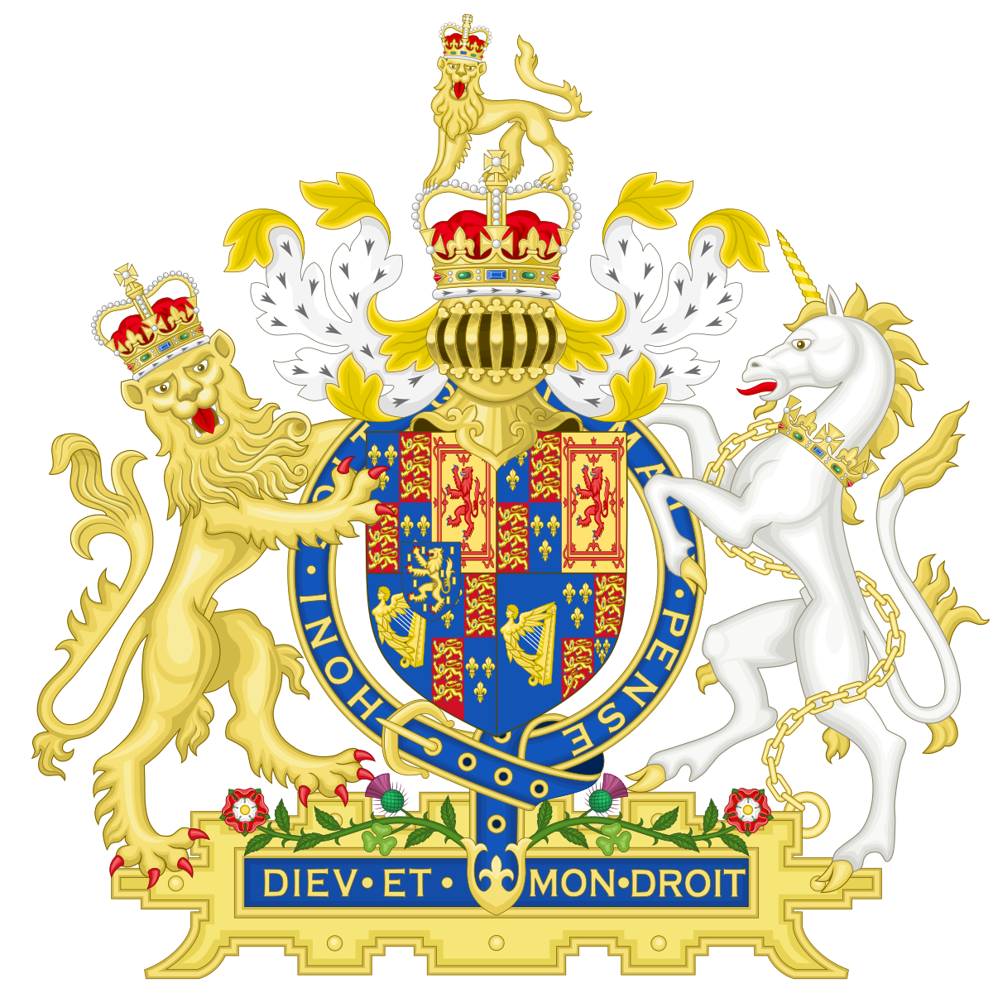
English bill of rights
Signed into English law after the “Glorious revolution” in 1688.
Only parliament can tax.
Right to trial by jury.
No cruel and unusual punishments.
Right to petition the government for redress of wrongs.

Slide 5
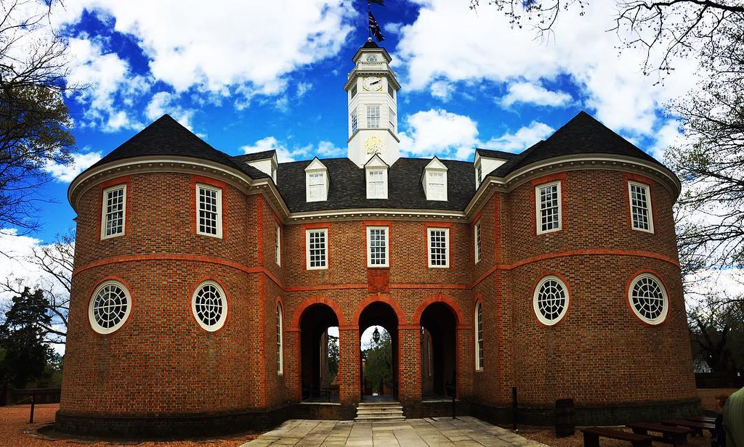
House of burgesses
Virginia’s elected colonial legislature: the 1st one in the 13 colonies.
Only white, male landowners could elect representatives (vote).
Even so, this was self-government in America.

Slide 6
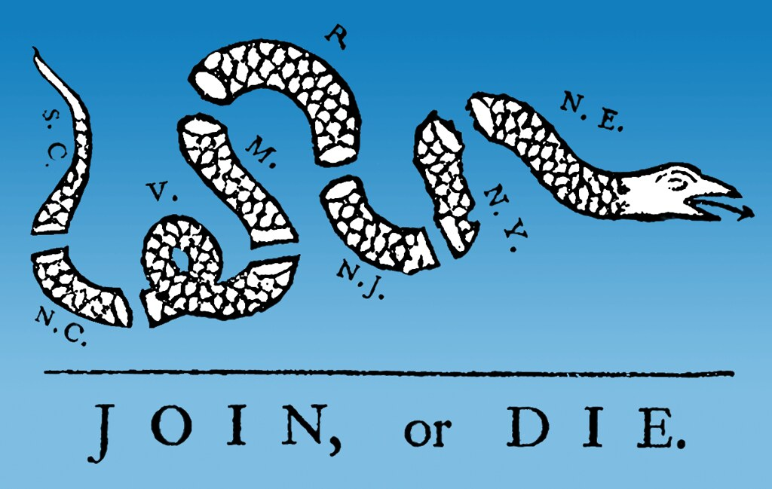
Albany plan of union
Self government was local, each colony was independent from the others.
In 1754, war between the British and the French over the ohio valley.
Albany plan of union was written by ben franklin proposing a confederation.
An alliance between colonies for common defense.
Modeled after Athens and the Iroquois league.
Franklin’s proposal was rejected due to pressure from the king of England.

Slide 7
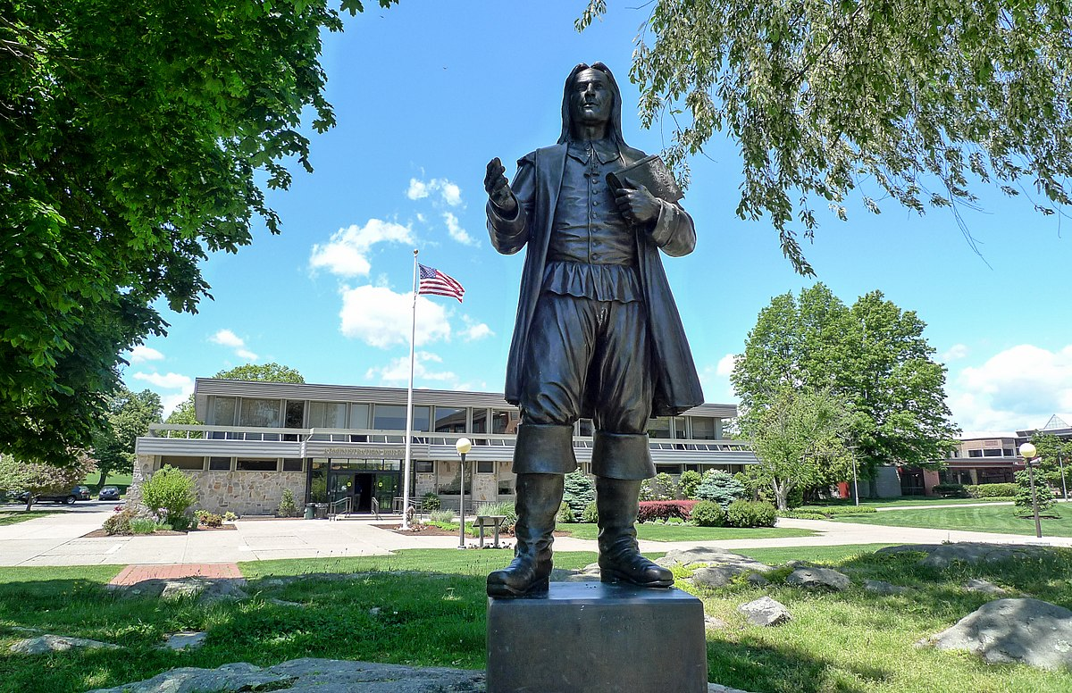
Colonies divided by religion
Many different Christians came over to the colonies.
Puritans in new England
Catholics in Maryland
Quakers in Pennsylvania
Roger Williams was kicked out of Massachusetts for preaching freedom of religion founded the Rhode Island colony.

Slide 8
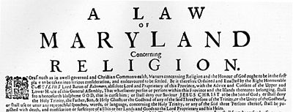
Act of religious toleration
1649: an attempt to stop the fighting between Catholics and Protestants.
Act of Religious Toleration declares that Christians should not be troubled for practicing their religion.
This toleration did not extend to other religious groups.

Slide 9
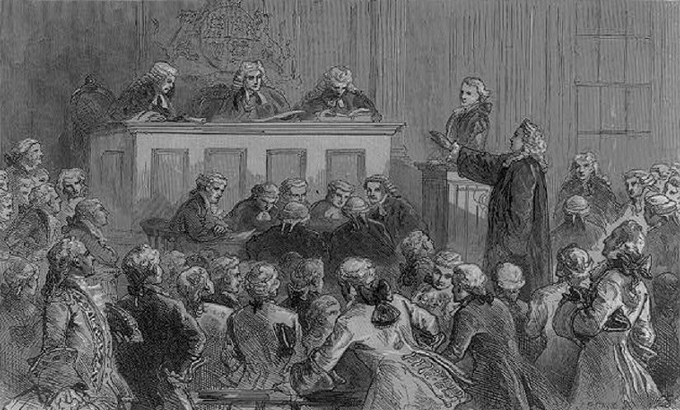
The Zenger Trial
1734: John Peter Zenger was a New York printer who got arrested for publishing “seditious libels” or rebellious statements
His lawyer argued that he didn’t lie, and that people should be free to call out abuses of power publicly.
Zenger was found innocent, and this verdict helped promote freedom of the press.

